Slide 1
Major Project Presentation
Chhatrapati Shivaji Institute of Technology, Durg
Computer Science & Engineering Department
Semester – 8th
Section - B
Programmer’s Keyboard
Presenting a brief idea of our project, proposed by
Annim Banerjee ( 101 )
Rishabh Sharma ( 106 )
Srijan Tiwari ( 87 )
Under the Supervision of
Mr. Saket Soni.
Asst. Professor
CSE Department.

Slide 2
Contents
Abstract.
Introduction.
Application & Features.
Working and Methodology.
Requirements.
Bibliography.

Slide 3
Contents
Abstract.
Introduction.
Application & Features.
Working and Methodology.
Requirements.
Bibliography.

Slide 4
Abstract

Slide 5
Programmer’s Keyboard: Abstract
Designing and building of a keyboard with those feature which helps in speeding up the programmer or say to coder to do coding on the respective IDE editor window.

Slide 6
Introduction

Slide 7
Programmer’s Keyboard: Introduction…
This project is partly based on embedded systems and rest of the part is software based.
Special key sets are provided which are dedicated to do specific task.
This project is been developed keeping the programmers as our audience.
For now, this will be developed for windows platform.

Slide 8
Programmer’s Keyboard: Introduction…
This project will not be developed as per IEEE, FCC( Federal Communication Commission ) Electronics specification.
This keyboard will have a USB interface to connect with your system.
A software will be developed further for rendering this keyboard from your system.
That software will reside on computer system.

Slide 9
Application & Feature

Slide 10
Application & Feature…
Application
  Auto Completion of the coding snippets for you on the IDE you are working at that instant, as per the given functionality on the key you pressed.
  You can choose the language which you are working on with from tray icon area, then this will put the snippets on the window for the same.
  Another category, irrespective of the language you are working with, just select the code snippets you want to use.

Slide 11
Application & Feature…
Hardware Features
  20-30 keys on board.
  USB interface for communication with the computer system.
  Controllers on option
    NXP: 8051.
    Atmel: ATmega168/328
  May have a fancy hardware design.
  Power will be taken from computer via USB.

Slide 12
Application & Feature…
Software Features
  Will process the data which comes from the keyboard via USB communication port.
  Application may be running on Notification Tray. From here, you can select the working language choice, or can select the snippets directly.
  May be a windowed application but not a full fledge one.
  Without this application running on the system, you cannot use the keyboard.
  A driver software is required for communication with this keyboard.

Slide 13
Working and Methodology

Slide 14
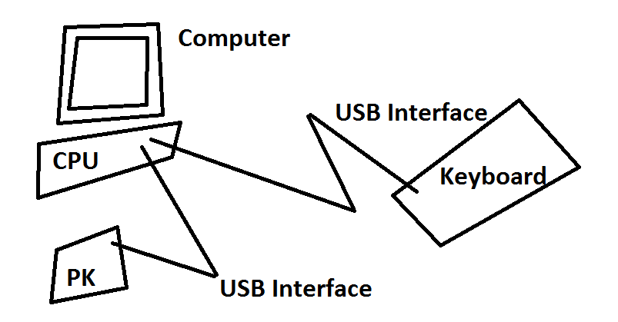
Working and Methodology
A setup of our keyboard with computer system.

Slide 15
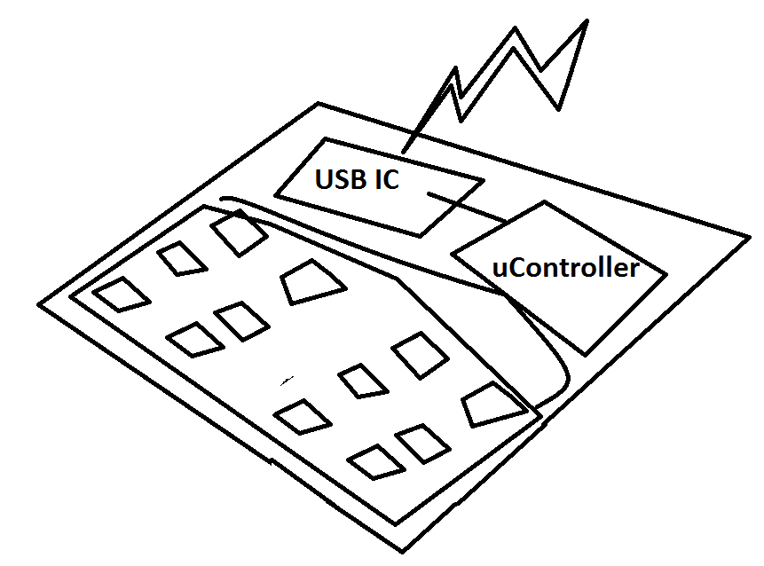
Working and Methodology
Magnified view of our keyboard which gets connected to Computer…

Slide 16
Requirements

Slide 17
Programmer’s Keyboard : Requirements
Software Development Requirements
  C++ (using WinAPI).
  Visual Studio Express Edition 2010.
  SDCC(Small Device C Compiler) compiler for embedded C programming on the micro controller.
  Flash Magic program for burning the code on to micro controller.

Slide 18
Programmer’s Keyboard : Requirements
Hardware Development Requirements
  Breadboard.
  Hookup Wires.
  Multi meter.
  4 pin keys.
  Microcontroller for development.
  USB interface module breakout.
  Matrix Keypad.

Slide 19
References
Internet & Books
  http://pcbheaven.com/wikipages/How_Key_Matrices_Works/
  http://www.engineersgarage.com/microcontroller/8051projects/interface-keypad-AT89C51-circuit
  http://ece.jagansindia.in/2011/02/basic-8051-microcontroller-circuit/
  http://sdcc.sourceforge.net/index.php#Who
  The 8051 Microcontroller and Embedded Systems Using Assembly and C.

Slide 20
Thank You

